Slide 1

CSE3151
Computer Networks
(Session 2018-19)
Dr. Asif Zaman
Associate Professor, CSE, RU

Slide 2
Internetworks
https://www.submarinecablemap.com/

Slide 3
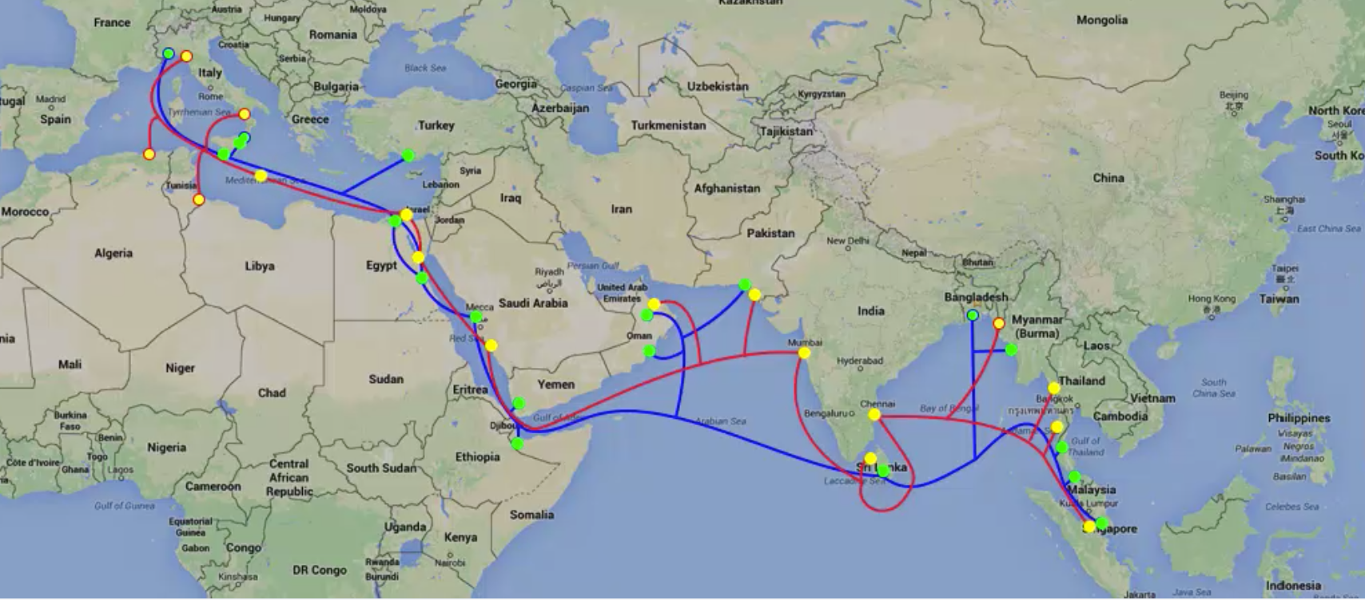
Internetworks

Slide 4
Network Software
The first computer networks were designed with the hardware as the main concern and the software as an afterthought.
This strategy no longer works.
To reduce their design complexity, most networks are organized as a stack of layers or levels, each one built upon the one below it.

Slide 5
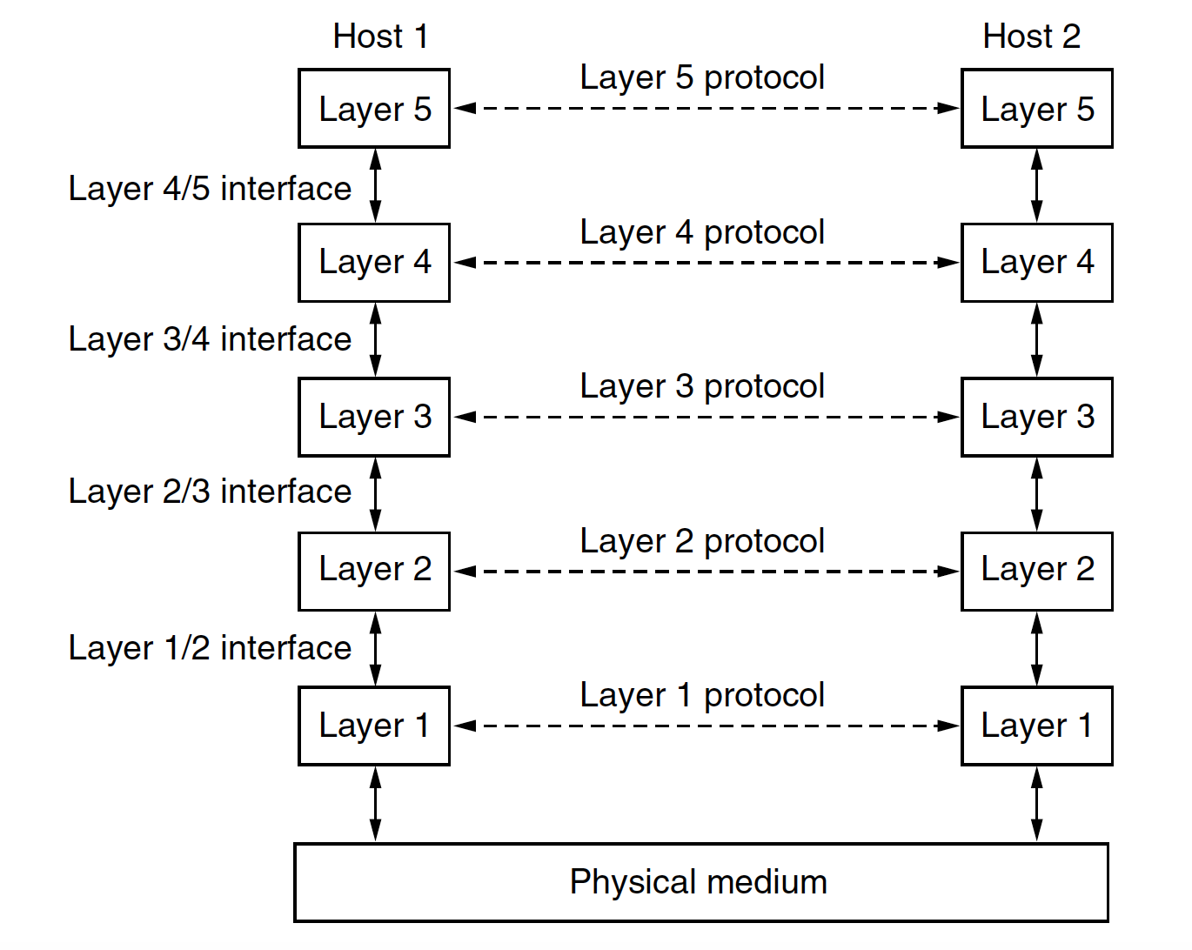
Network Software
A protocol is an agreement between the communicating parties on how communication is to proceed.
Peer – both host
A set of layers and protocols is called a network architecture.
A list of the protocols used by a certain system, one protocol per layer, is called a protocol stack.

Slide 6
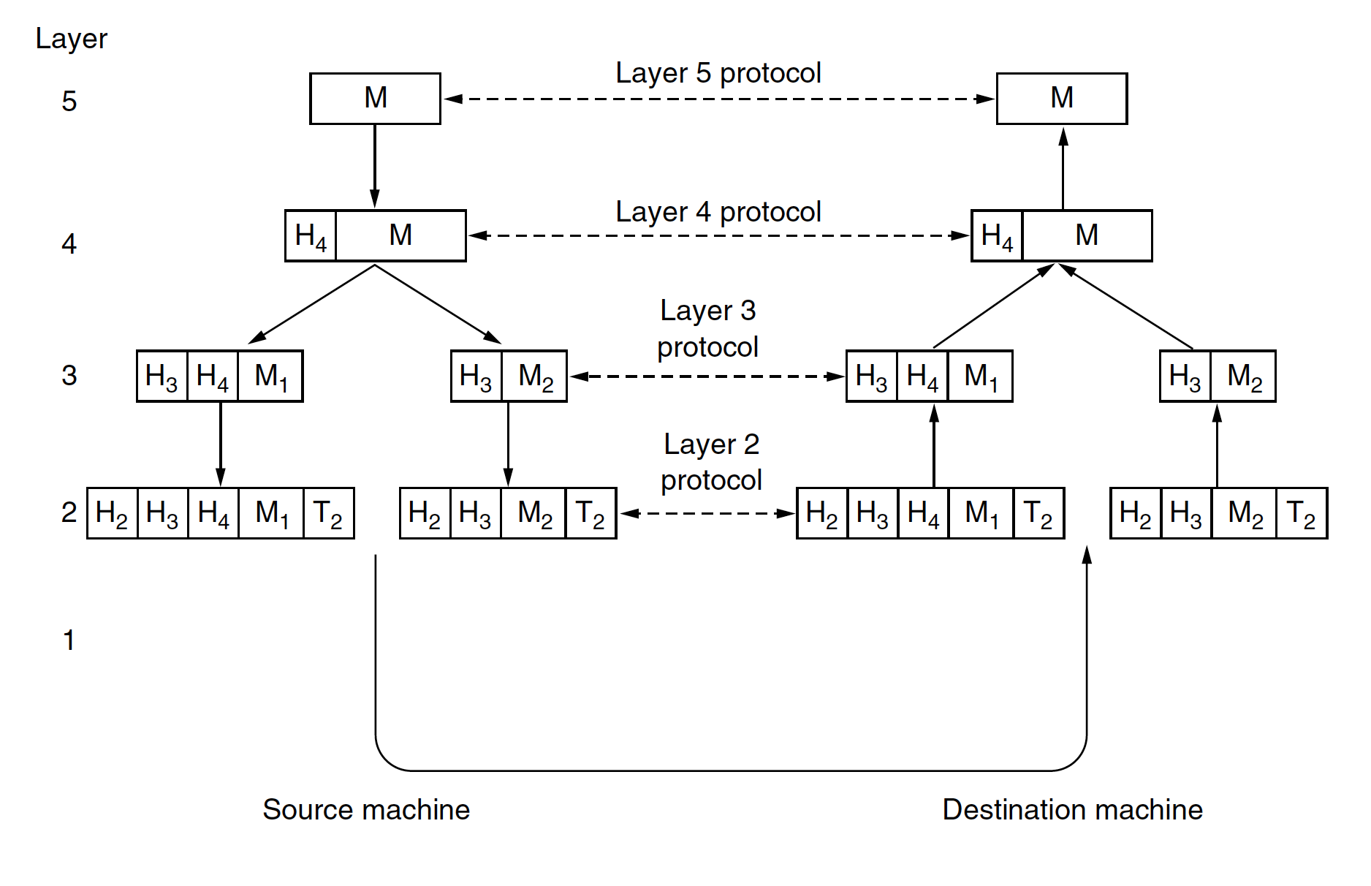
Network Software

Slide 7
Design Issues for the Layers
Reliability
uses codes for error detection.
error correction
They are used at low layers,
Routing
Finding a working path through a network
addressing or naming,
internetworking.

Slide 8
Design Issues for the Layers
Resource allocation.
Who will get priority
flow control.
Quality of service
Confidentiality
authentication
Integrity

Slide 9
Reference Models
Two Popular Reference models
OSI (Open Systems Interconnection)
protocols associated with the OSI model are not used any more, the model itself is actually quite general and still valid, and the features discussed at each layer are still very important
TCP/IP

Slide 10
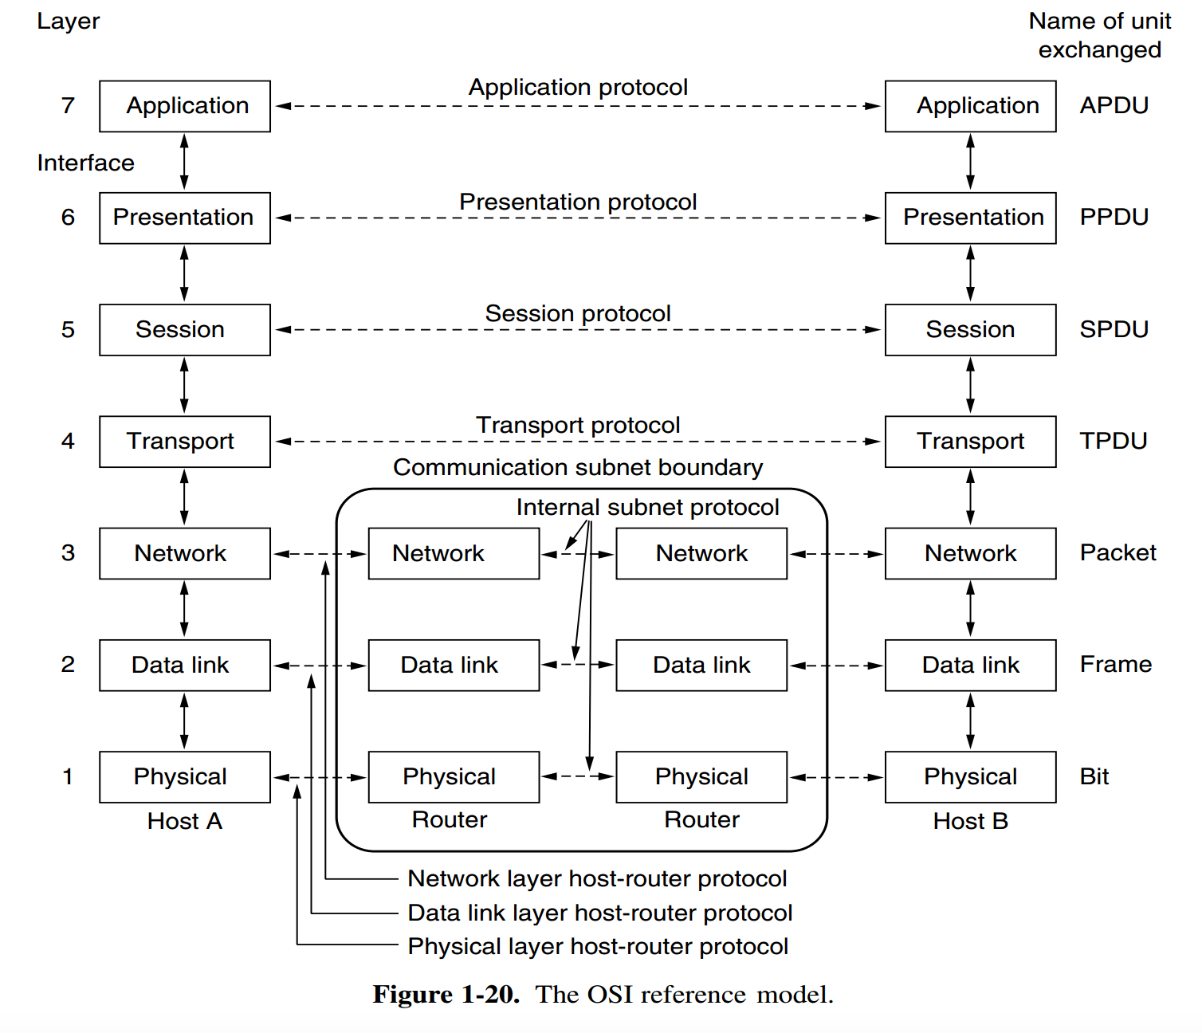
OSI Reference Model
All People Seem To Need Data Processing

Slide 11
The Physical Layer
The physical layer is concerned with transmitting raw bits over a communication channel.
The design issues have to do with making sure that
when one side sends a 1 bit it is received by the other side as a 1 bit, not as a 0 bit.
what electrical signals should be used to represent a 1 and a 0,
how many nanoseconds a bit lasts,
whether transmission may proceed simultaneously in both directions,
how the initial connection is established,
how it is torn down when both sides are finished,
how many pins the network connector has, and
what each pin is used for.

Slide 12
The Data Link Layer
The main task of the data link layer is to transform a raw transmission facility into a line that appears free of undetected transmission errors.
It accomplishes this task by having the sender break up the input data into data frames (typically a few hundred or a few thousand bytes) and transmit the frames sequentially.
The receiver confirms correct receipt of each frame by sending back an acknowledgement frame.

Slide 13
The Data Link Layer

Slide 14
The Network Layer
A key design issue is determining how packets are routed from source to destination.
More generally, the quality of service provided (delay, transit time, jitter, etc.) is also a network layer issue

Slide 15
The Transport Layer
The basic function of the transport layer is to:
accept data from above it,
split it up into smaller units if need be,
pass these to the network layer, and
ensure that the pieces all arrive correctly at the other end.

Slide 16
The Session Layer
The session layer allows users on different machines to establish sessions between them.
Sessions offer various services:
including dialog control (keeping track of whose turn it is to transmit),
token management (preventing two parties from attempting the same critical operation simultaneously), and
synchronization

Slide 17
The Presentation Layer
Unlike the lower layers, which are mostly concerned with moving bits around, the presentation layer is concerned with the syntax and semantics of the information transmitted.
In order to make it possible for computers with different internal data representations to communicate, the data structures to be exchanged can be defined in an abstract way, along with a standard encoding to be used ‘‘on the wire.’’
The presentation layer manages these abstract data structures and allows higher-level data structures (e.g., banking records) to be defined and exchanged

Slide 18
The Application Layer
The application layer contains a variety of protocols that are commonly needed by users.
One widely used application protocol is HTTP (HyperText Transfer Protocol), which is the basis for the World Wide Web.
When a browser wants a Web page, it sends the name of the page it wants to the server hosting the page using HTTP.
The server then sends the page back. Other application protocols are used for file transfer, electronic mail, and network new

Slide 19
OSI Reference Model

Slide 20
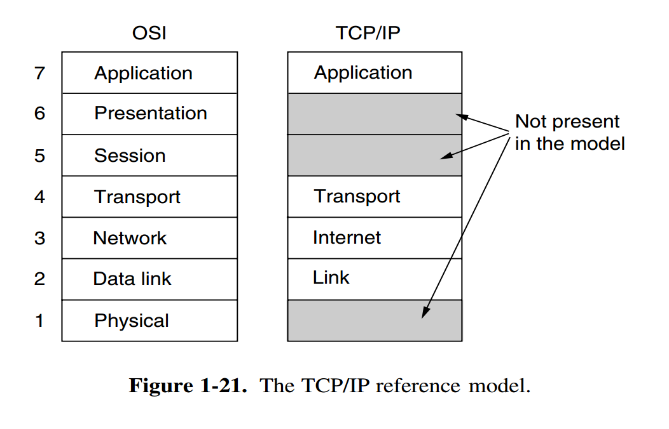
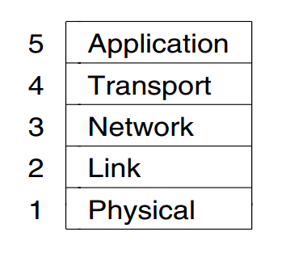
TCP/IP Reference Model

Slide 21
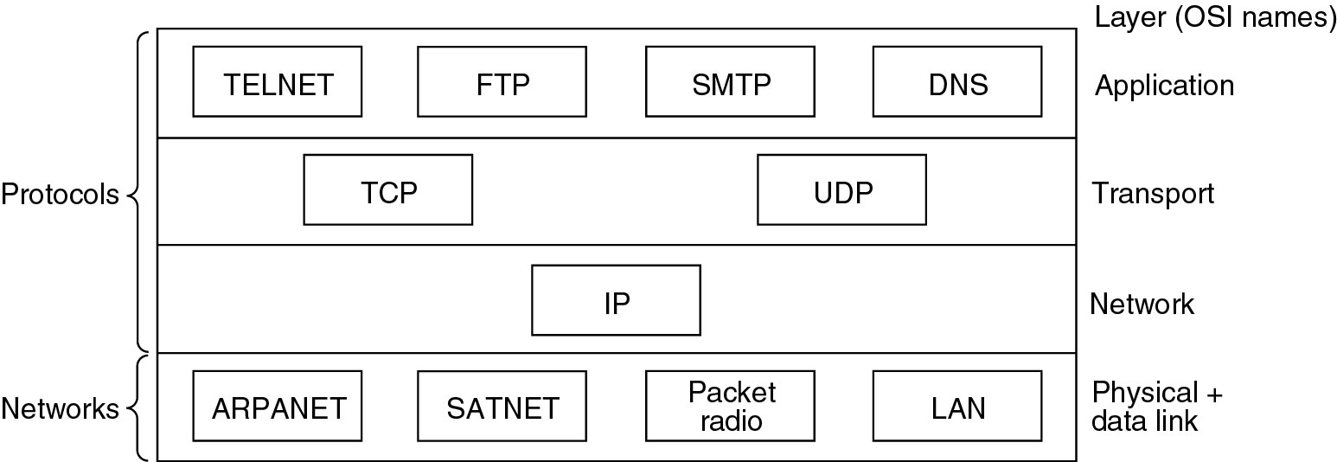
Protocols and networks in the TCP/IP model initially.

Slide 22
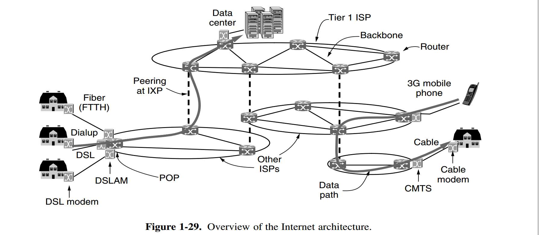
DSL- Digital Subscriber Line
DSLAM - Digital Subscriber Line Access Multiplexer
Module- modulator demodulator
CMTS - Cable Modem Termination System
FTTH - Fiber to the Home
POP -Point of Presence
Notes:
Add a logical view

Slide 23
ISP networks may be regional, national, or international in scope
ISPs connect their networks to exchange traffic at IXPs (Internet eXchange Points)
Basically, an IXP is a room full of routers, at least one per ISP.
A LAN in the room connects all the routers, so packets can be forwarded from any ISP backbone to any other ISP backbone
Notes:
Add a logical view

Slide 24
Basic Internet Structure

Slide 25
Basic Internet Structure

